Slide 1
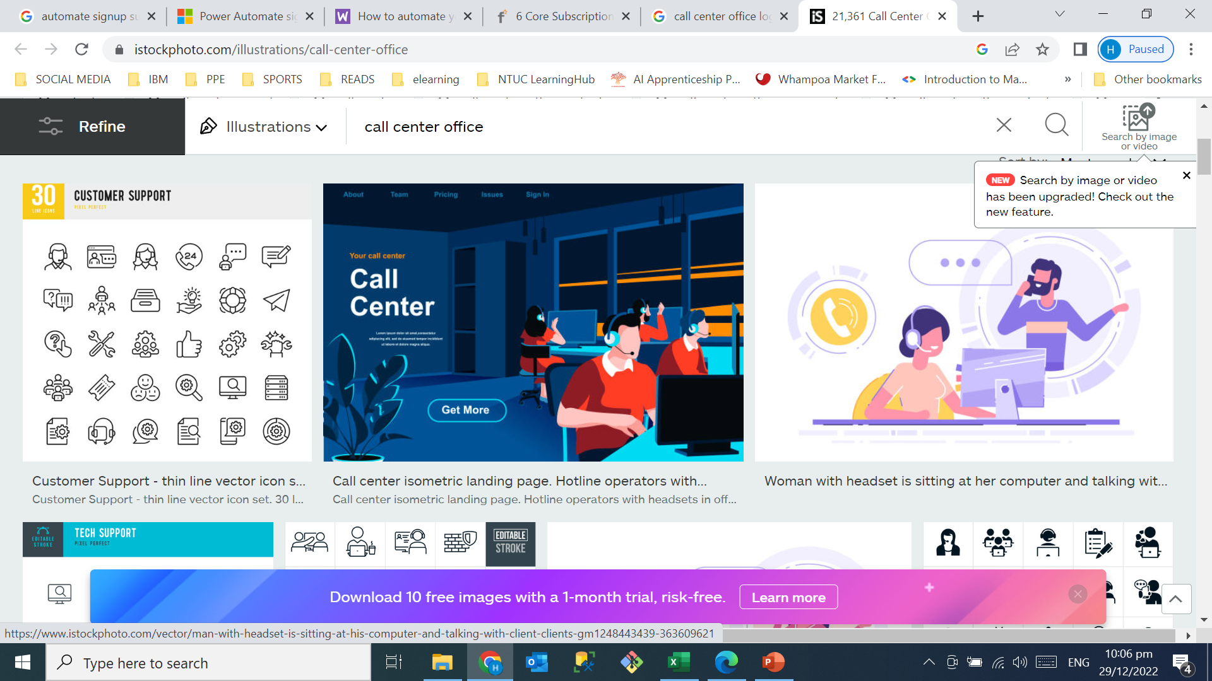
Data Analysis
Case Volume Analysis
Notes:
The aim of this project is to analyze case volume for call center.

Slide 2
CONTENTS
1. Brief Introduction
About the Business
Data collection & source
2. Data Preparation using Power Query
Data Cleaning
Data Transformation
Data Normalization
3. Entity Relationship Diagram (ERD)
4. Data Analysis using Structured Query Language (SQL)
5. Summary
Notes:
This presentation is divided into 5 parts
I will start with high level introduction to the business, then briefly touch on data preparation using power query and ER diagram
I will share more business insights and findings in section 4
And in the last section, I will summarize a few key points to end the presentation.
So let’s get started.

Slide 3
CONTENTS
1. Brief Introduction
About the Business
Data collection & sources
2. Data Preparation using Power Query
Data Cleaning
Data Transformation
Data Normalization
3. Entity Relationship Diagram (ERD)
4. Data Analysis using Structured Query Language (SQL)
5. Summary

Slide 4
1. Brief Introduction
About the Business
FIN Expert Pte Ltd offers subscription-based digital product & services for financial advisory that includes newsletters, webinars, and investment recommendations to its customers.
The objective of this analysis is to analyze case volume for the Call Center, identify trends & patterns to obtain valuable business insights to improve its call center operations.
Historical dataset
3 years data extracted call center system
For Jan 2018 - Dec 2020
Total no. of rows = 177,149 case IDs
Total no. of columns = 16
Total no. of tables = 2
https://www.kaggle.com/datasets/gsagar12/dspp1?select=customer_product.csv
Notes:
FIN expert offers subscription based digital product for its customers and collect subscription fees from its subscribers.
A subscription business model is a recurring revenue model in which customers pay a weekly, monthly, or yearly fee in exchange for your products or services. Customers can renew their subscription after a certain period of time. This model allows you to leverage your customer relationships to create a steady stream of income.
In a subscription model, customers are charged on a recurring basis for a product or service. They choose how long and how often they want to receive each offer, and most subscriptions provide the option to renew or cancel at any time.
When the contract is up, the customer has the option to renew or cancel their subscription.
How to Build a Subscription Model:
1. Figure out if your business would benefit from offering subscriptions.
2. Establish a goal for your subscription-based business.
3. Choose a subscription pricing strategy.
4. Improve the user experience to get more sign-ups.
5. Create a seamless onboarding experience.
6. Make the billing process simple and easy
Benefits of a Subscription Business Model:
Subscription models are convenient for customers.
Customers can discover new products.
Businesses can accurately predict revenue.
Subscriptions can attract more customers.
Subscriptions decrease customer acquisition costs.
Businesses build stronger relationships with their customers.

Slide 5
CONTENTS
1. Brief Introduction
About the Business
Data collection & sources
2. Data Preparation using Power Query
Data Cleaning
Data Transformation
Data Normalization
3. Entity Relationship Diagram (ERD)
4. Data Analysis using Structured Query Language (SQL)
5. Summary

Slide 6
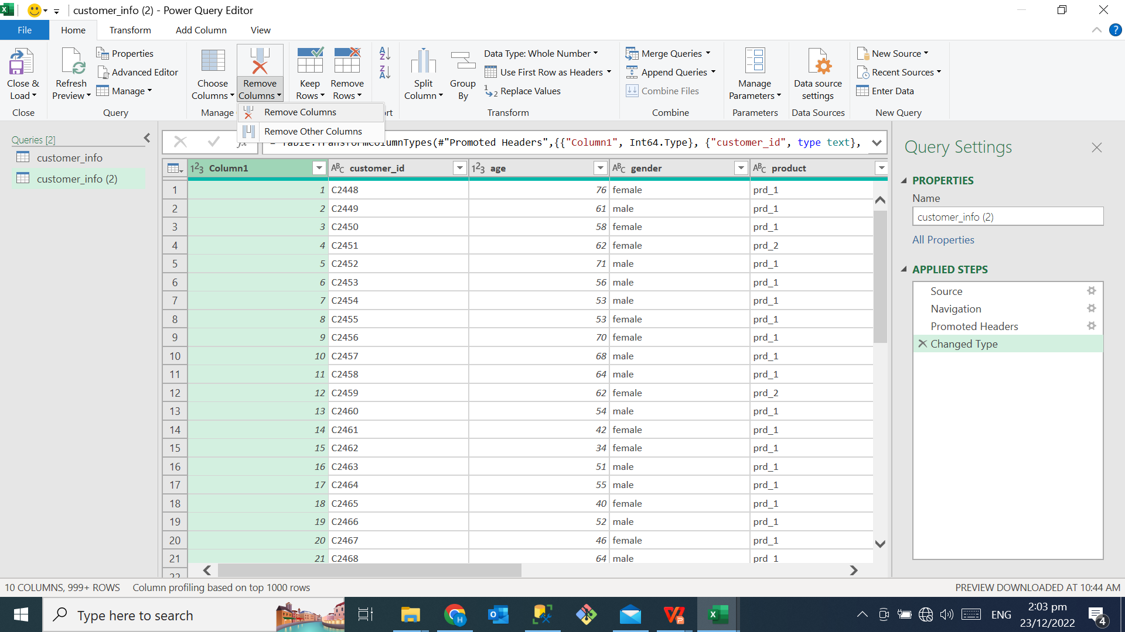
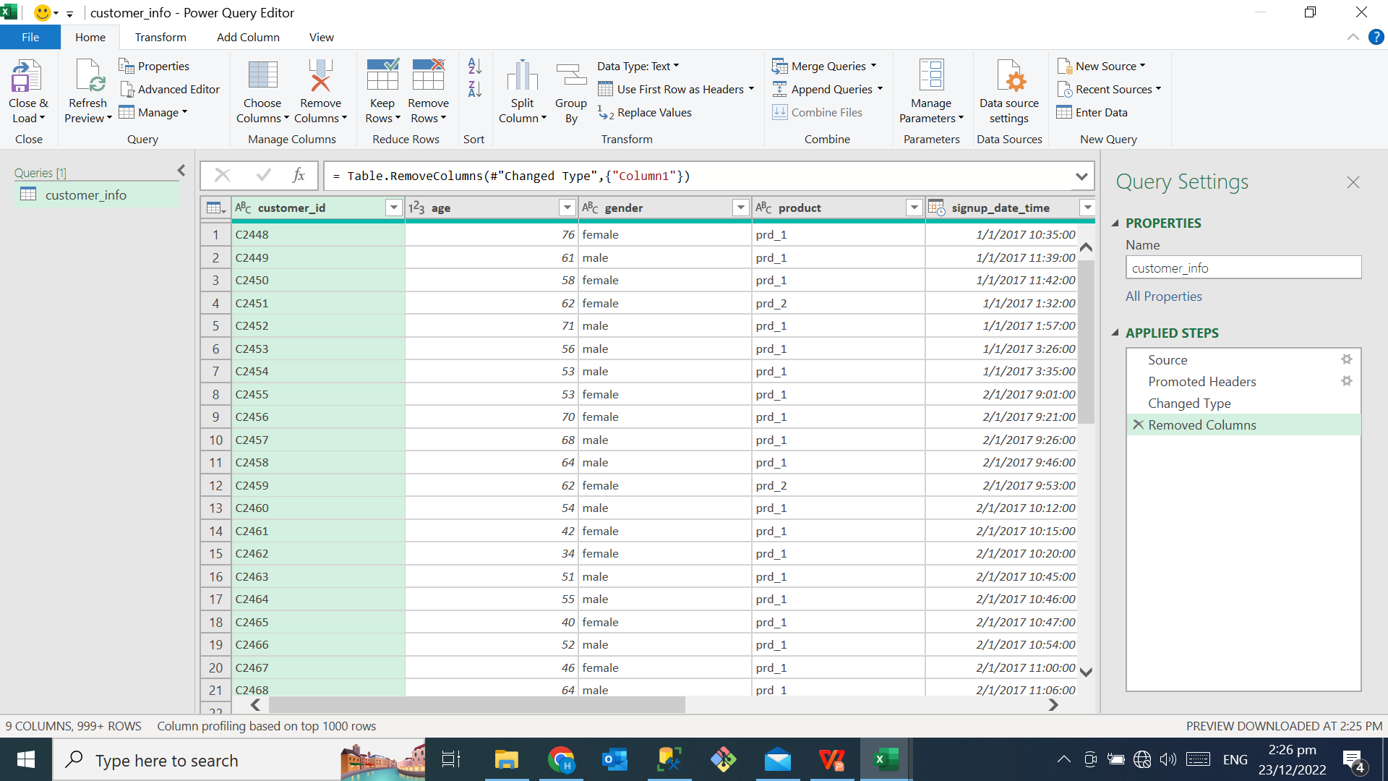
2. Data Preparation using Power Query
Steps performed:
Removed unwanted columns
Check duplicate rows
Ensure datatype in correct format
BEFORE
AFTER
Notes:
- Removed unwanted index column

Slide 7
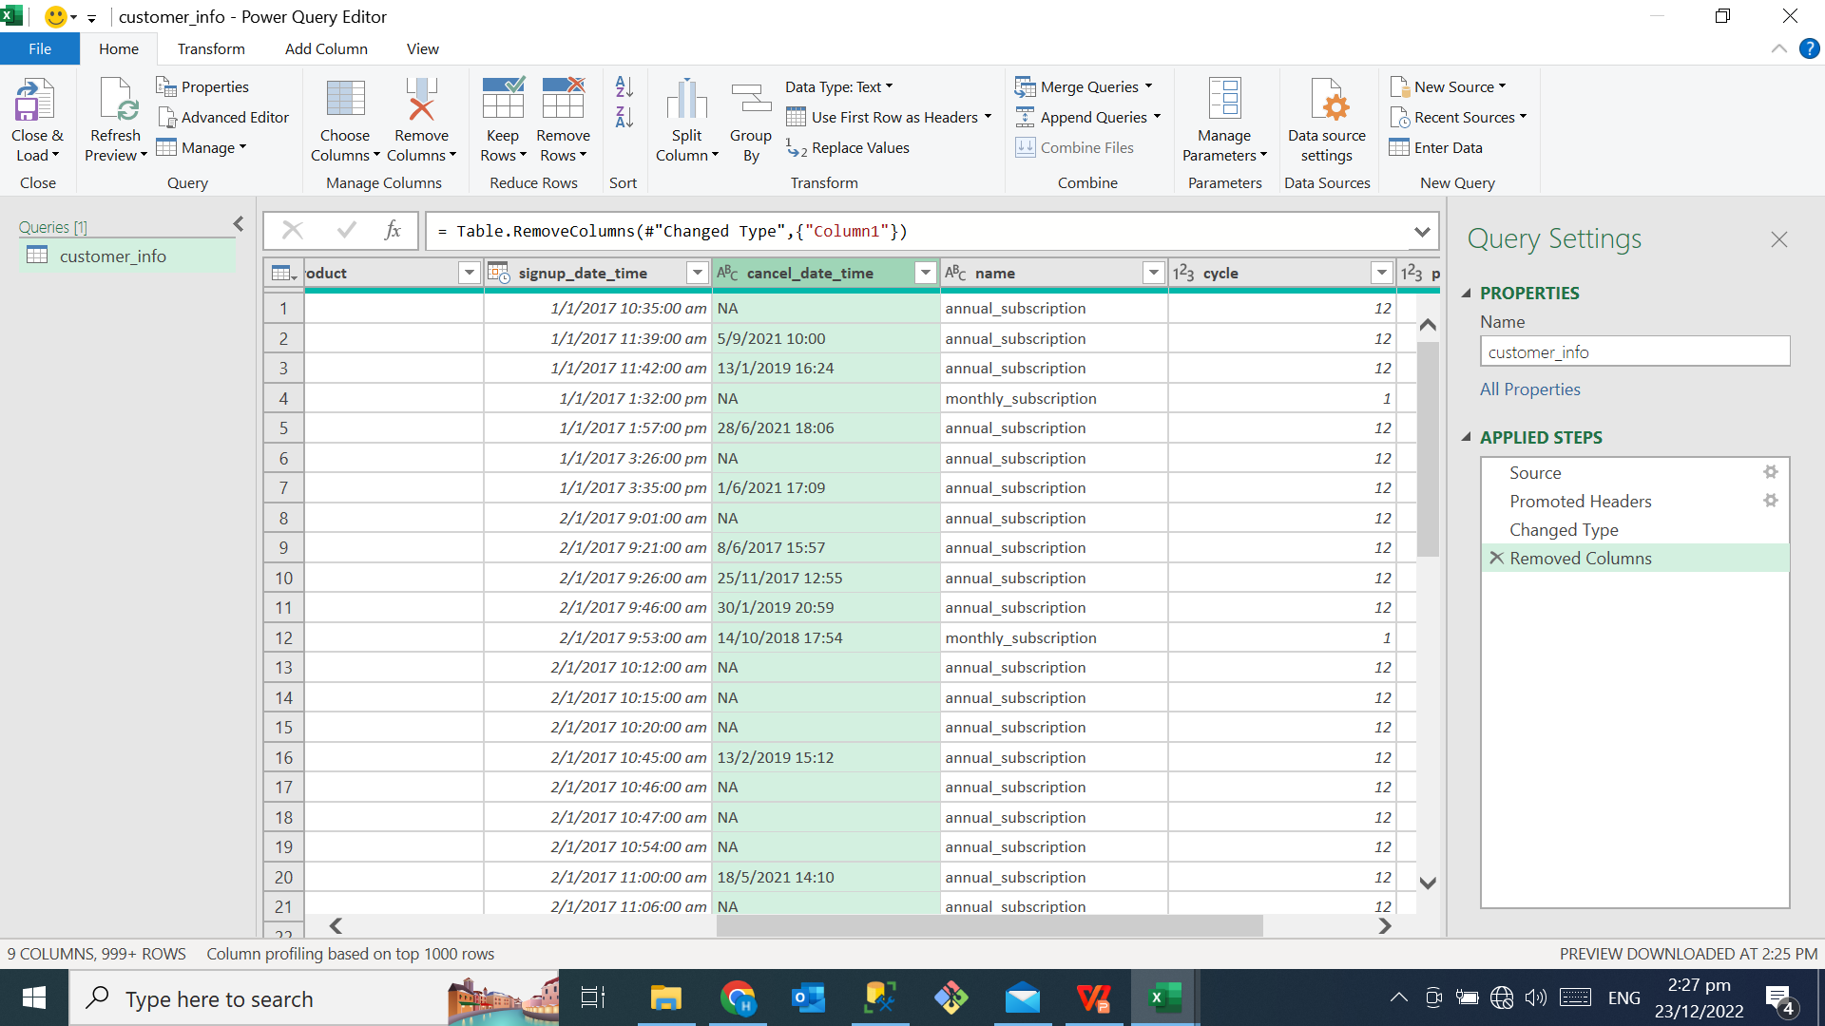
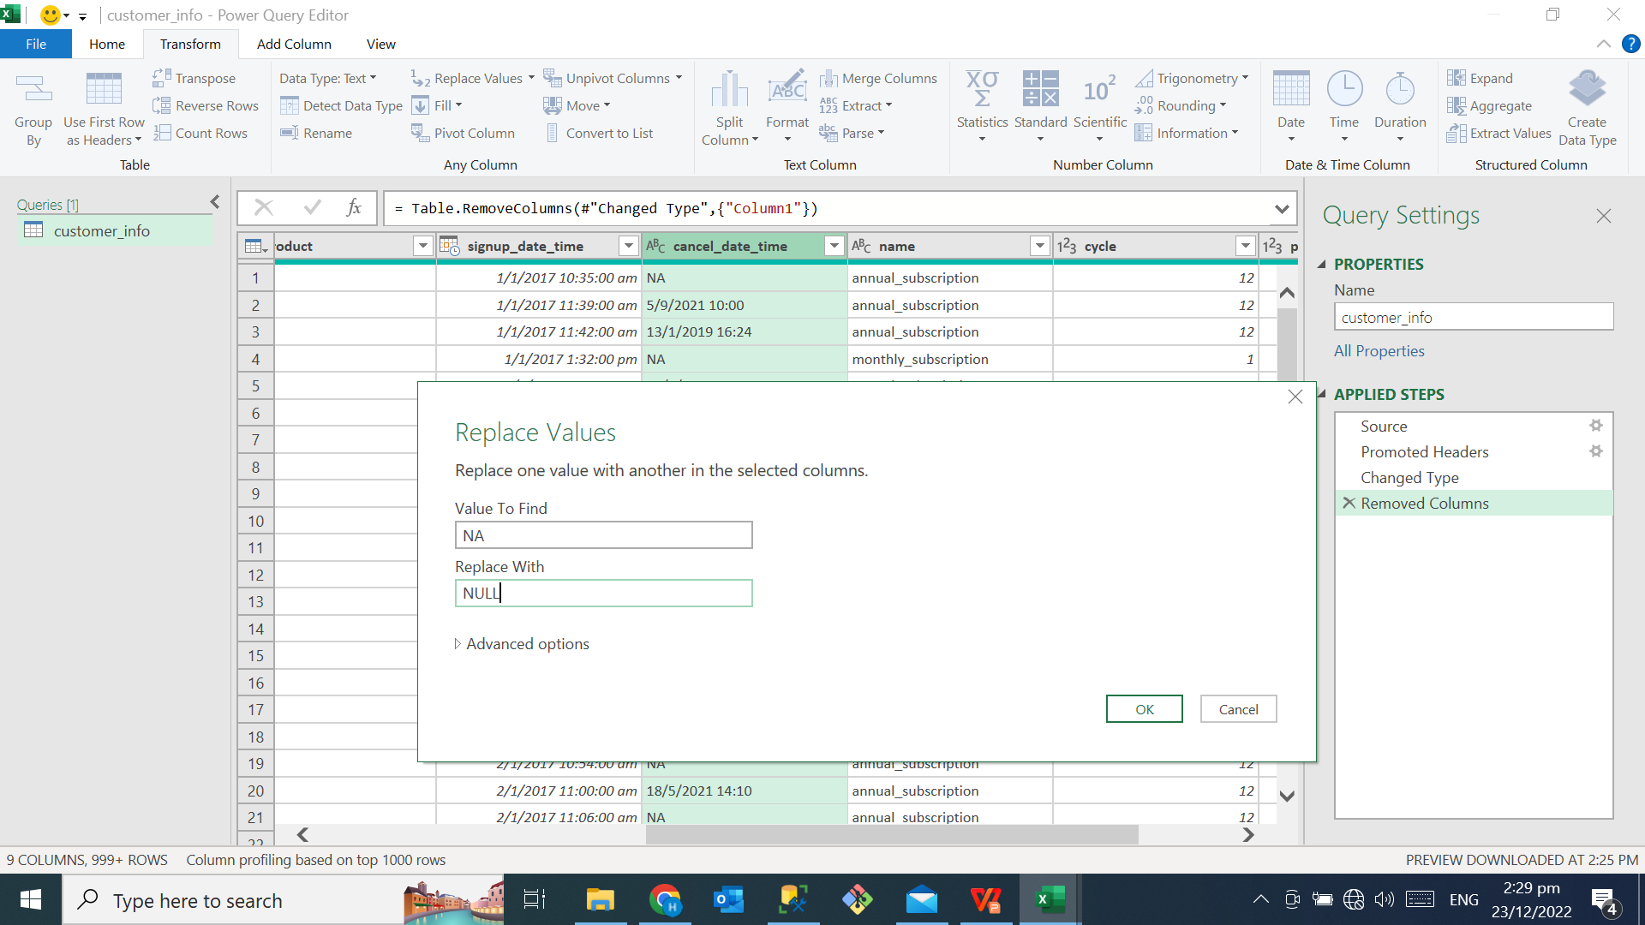
2. Data Preparation using Power Query
Rows with blank & NA values are replaced with NULL.
BEFORE
AFTER
Notes:
- Did not remove any rows from the tables, rows with blank values, NA are all replaced with NULL.

Slide 8
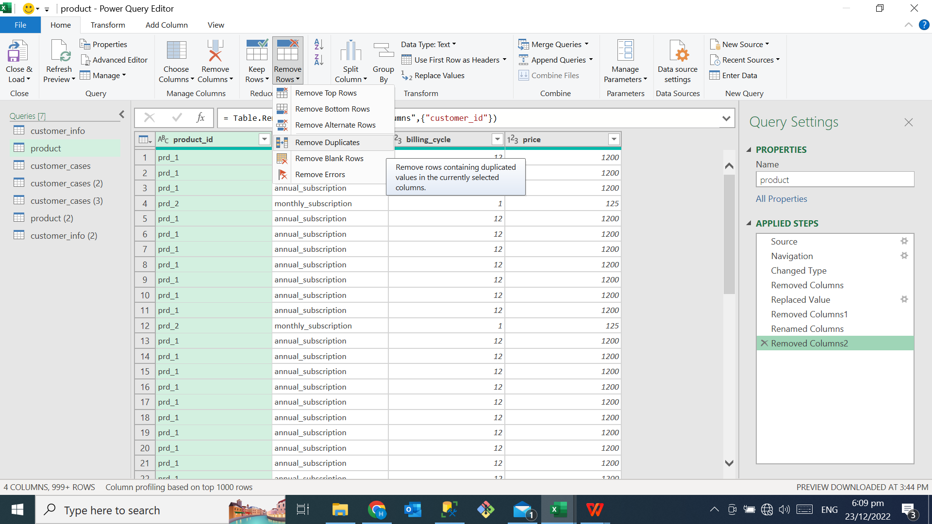
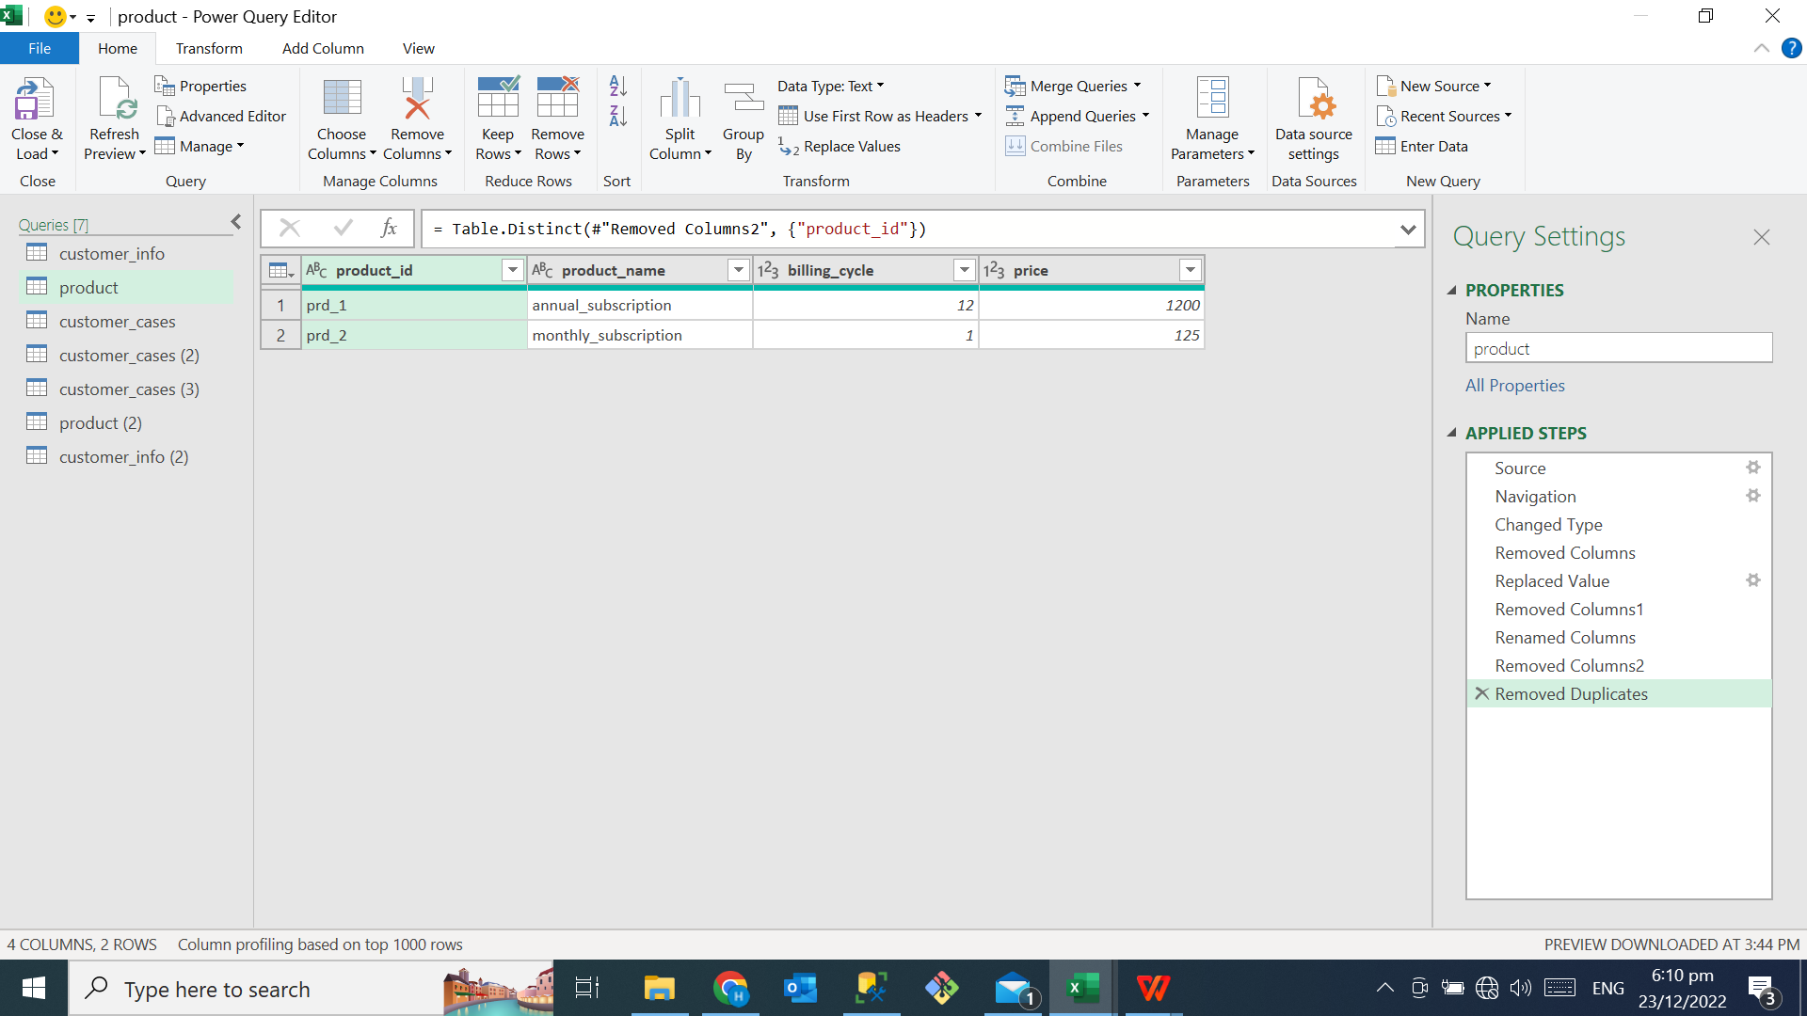
2. Data Preparation using Power Query
Performed data Normalization
Table name product_info.
After normalization, 2 normalized tables
BEFORE
AFTER
Notes:
Duplicate rows found in table product_info
Performed data normalization, table was reorganized, and split into 2 normalized tables.
Also defined relationship between the 2 tables.

Slide 9
CONTENTS
1. Brief Introduction
About the Business
Data collection & sources
2. Data Preparation using Power Query
Data Cleaning
Data Transformation
Data Normalization
3. Entity Relationship Diagram (ERD)
4. Data Analysis using Structured Query Language (SQL)
5. Summary
Notes:
We are now moving to section 3, …

Slide 10
3. Entity Relationship Diagram (ERD)
Customer_case
Customer_product
case_id (PK)
date_time
channel
reason
customer_id (FK)
customer_id (PK)
sign_up_date_time
cancel_date_time
product_id (FK)
has
has
has
Customer_info
Product_info
subscripted
product_id (PK)
product_name
billing_cycle
price
customer_id (PK)
age
gender
Notes:
i will not go explain each table in detail.
Basically, this slide is to show you that, 4 tables have been created after data preparation process,
We have also defined primary & foreign keys and relate these keys to the tables, this allows us extract data we needed from the database.
These 4 tables were imported to SQL Server Management Studio (SSMS) for our data analysis.

Slide 11
CONTENTS
1. Brief Introduction
About the Business
Data collection & sources
2. Data Preparation using Power Query
Data Cleaning
Data Transformation
Data Normalization
3. Entity Relationship Diagram (ERD)
4. Data Analysis using Structured Query Language (SQL)
5. Summary
Notes:
- Next moving on to section 4.

Slide 12
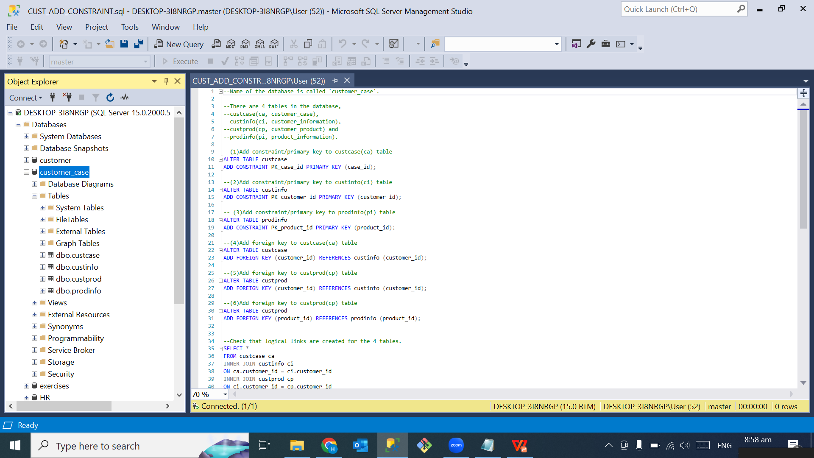
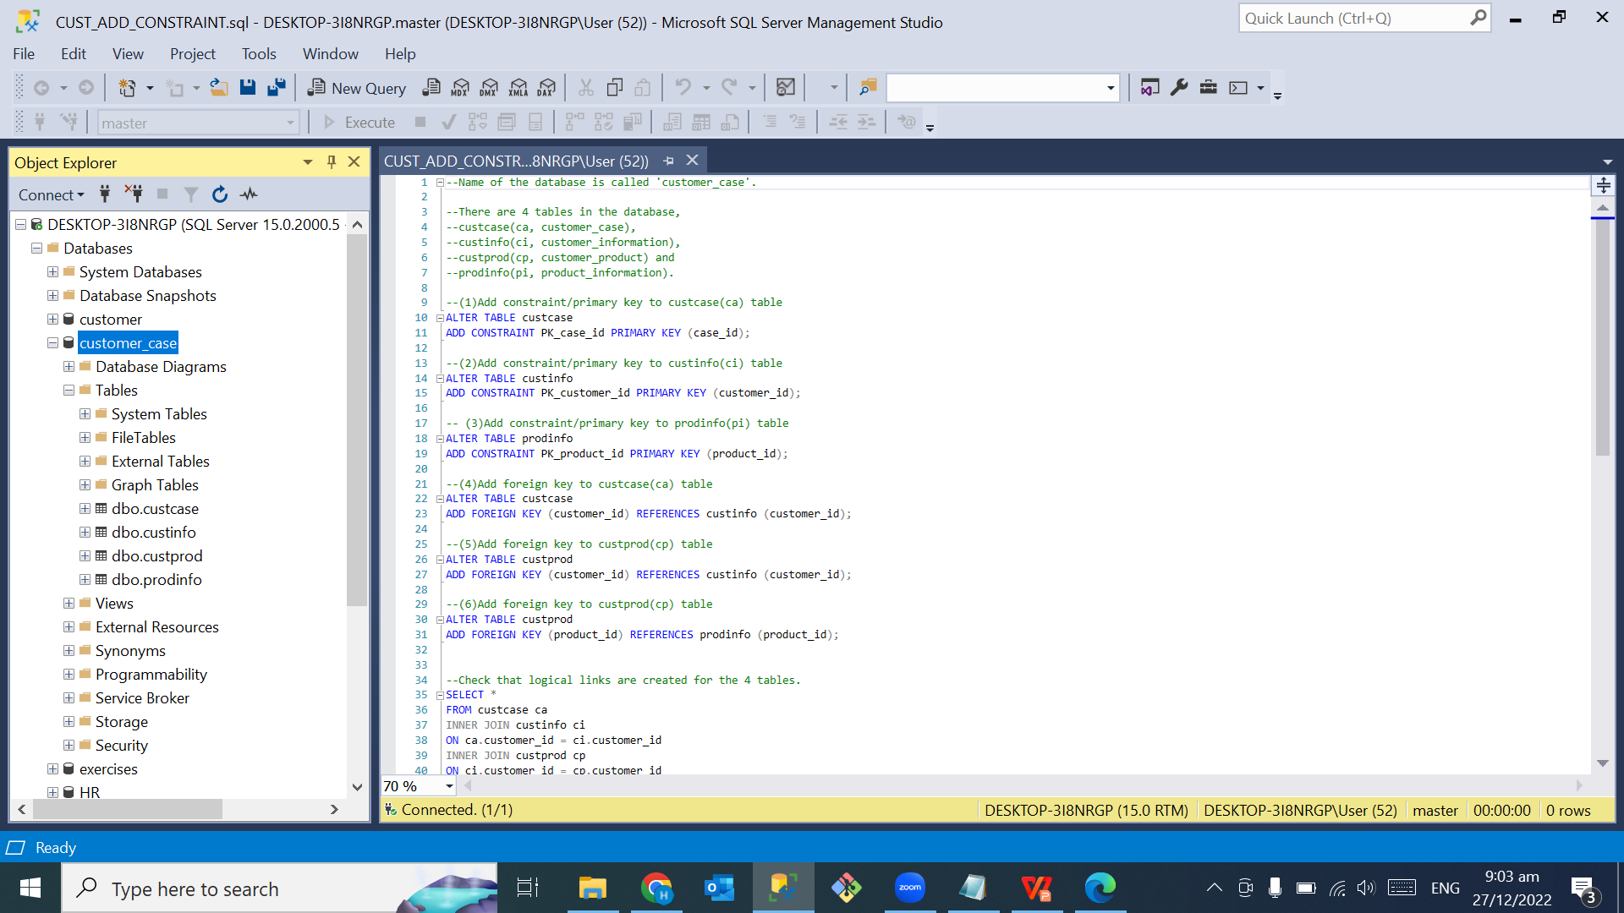
4. Data Analysis using SQL
Steps performed:
Created a database, named customer_case
Added constraints for the respective tables
created a database
added constraints
Notes:
A database has been created for the dataset, customer_case
Added constraints for the tables.

Slide 13
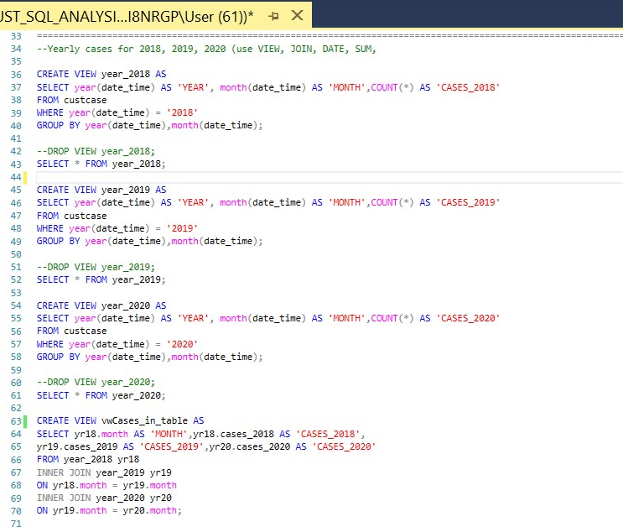
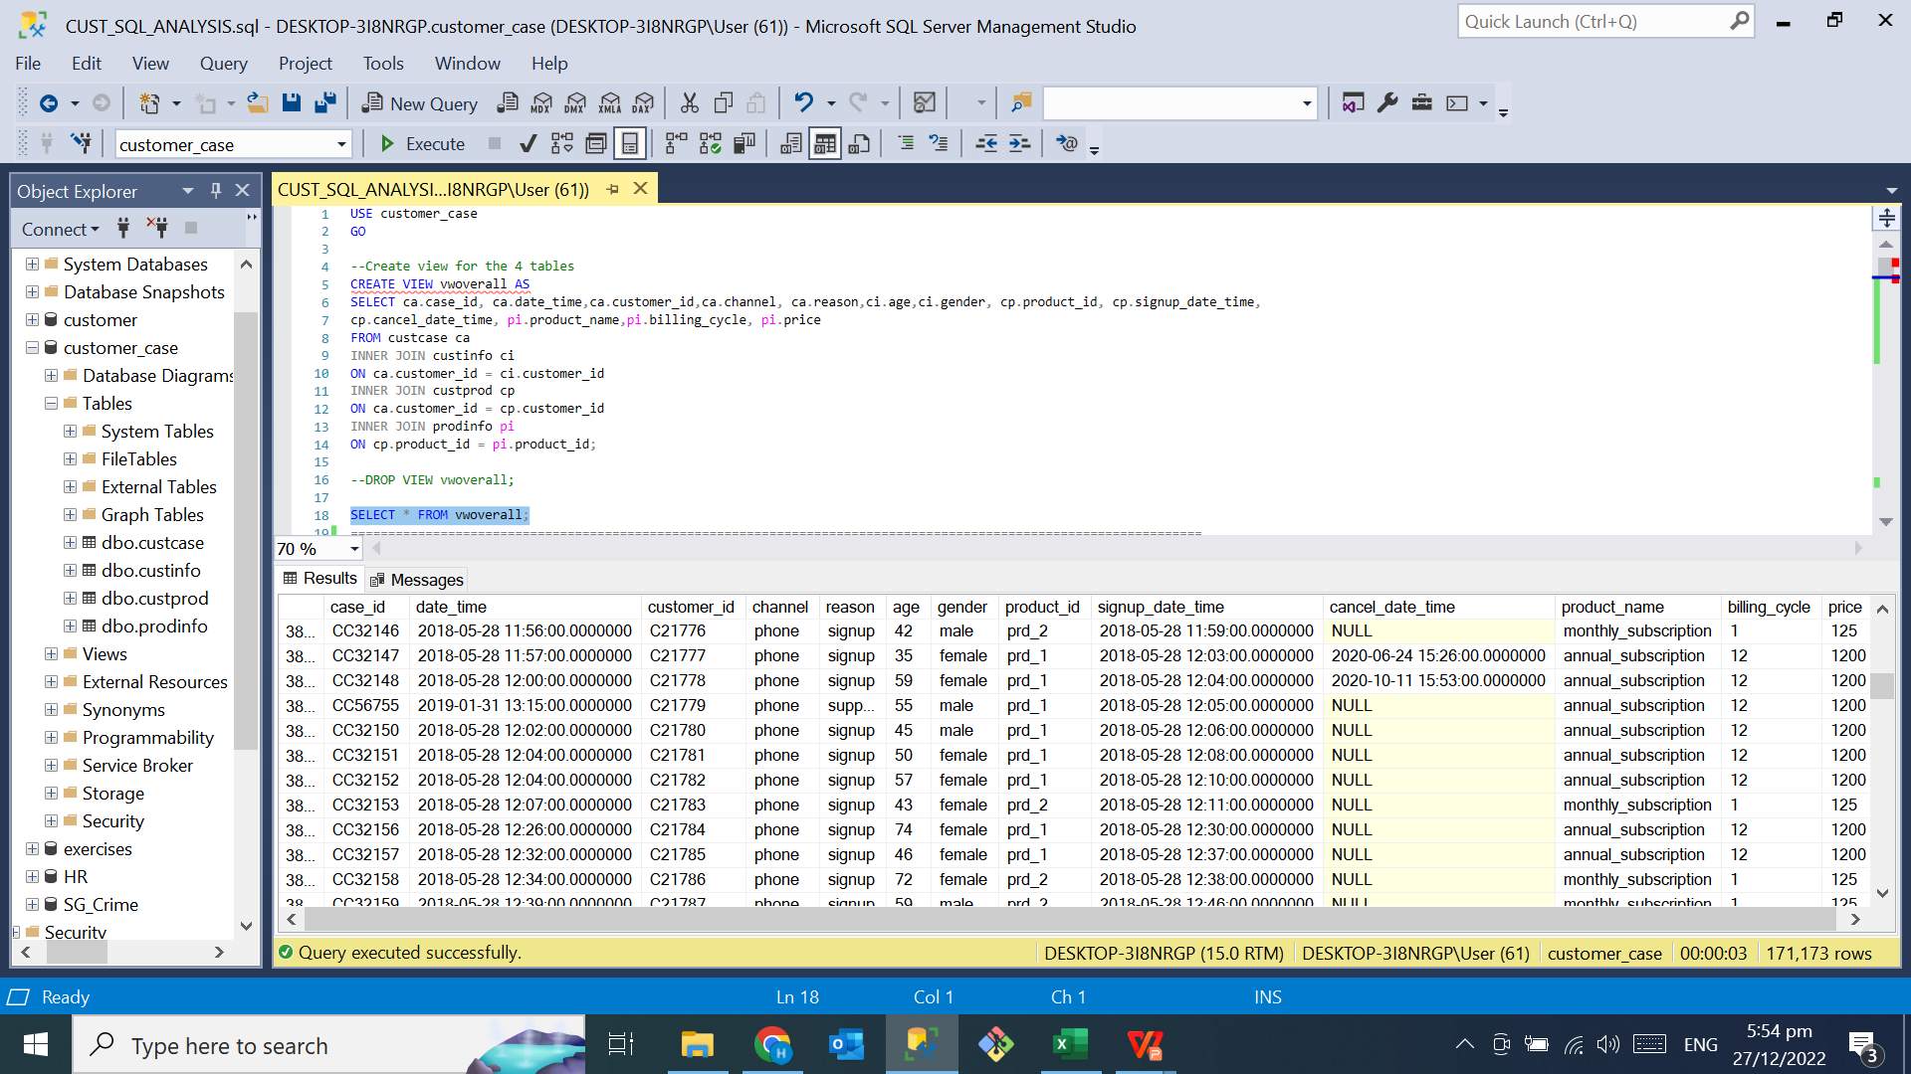
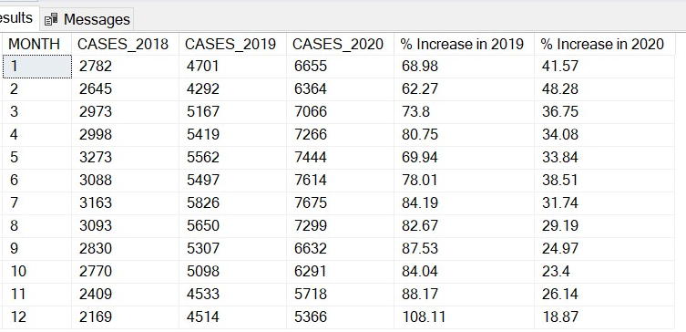
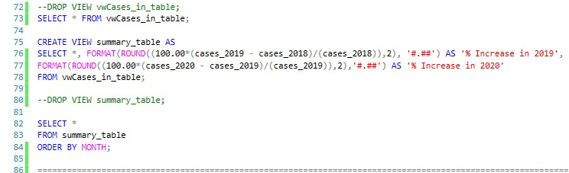
4. Data Analysis using SQL
Date and time were originally recorded in the same column in the dataset.
Extracted year, month and day for analysis.
BEFORE
AFTER

Slide 14
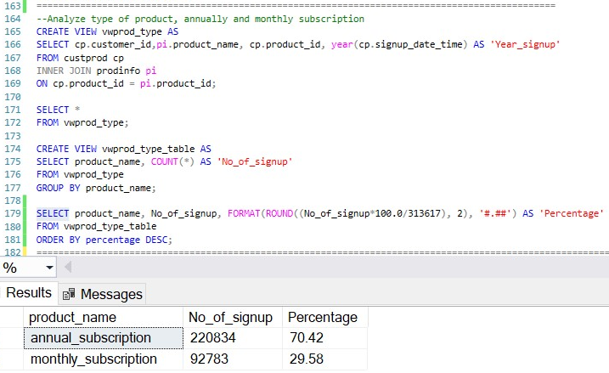
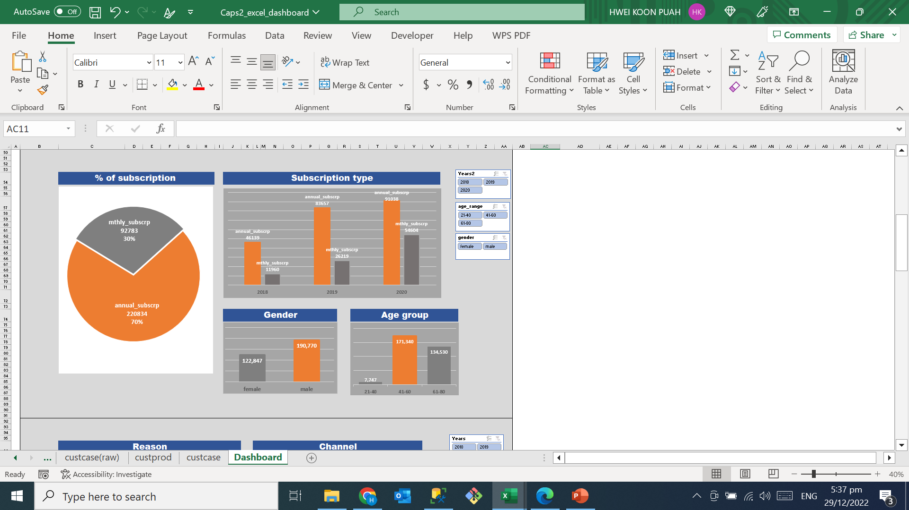
4. Data Analysis using SQL
70% of the total subscribers on annual subscription plan.
30% of the total subscribers on monthly subscription plan.
Notes:
- The dataset shows that majority of the subscribers are on yearly subscription plan while 30 % of the total subscribers are on monthly subscription plan.

Slide 15
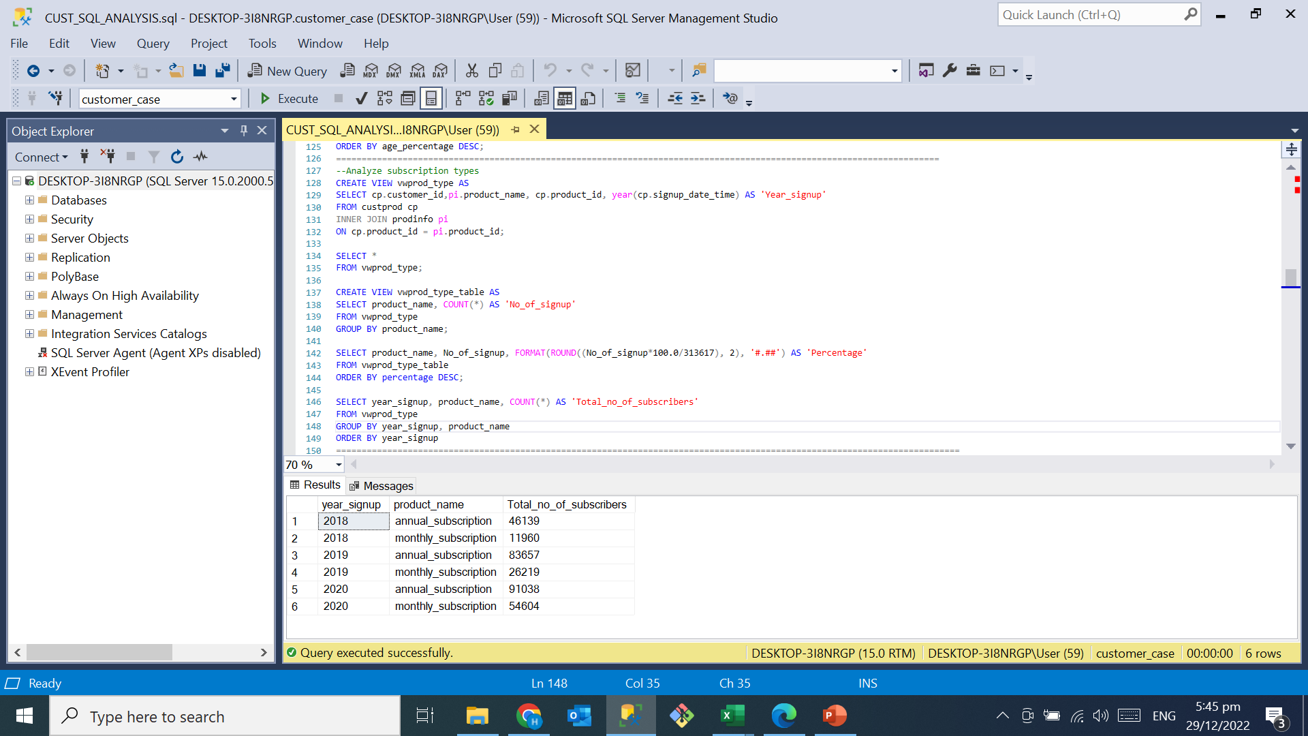
4. Data Analysis using SQL
More subscribers on yearly subscription plan.
Yearly fee priced = $1200 ($100 per month).
Monthly fee priced = $125 per month.
Monthly fee is higher.
Notes:
Yearly subscription fee is cheaper, this could be the reason why it is more popular.

Slide 16
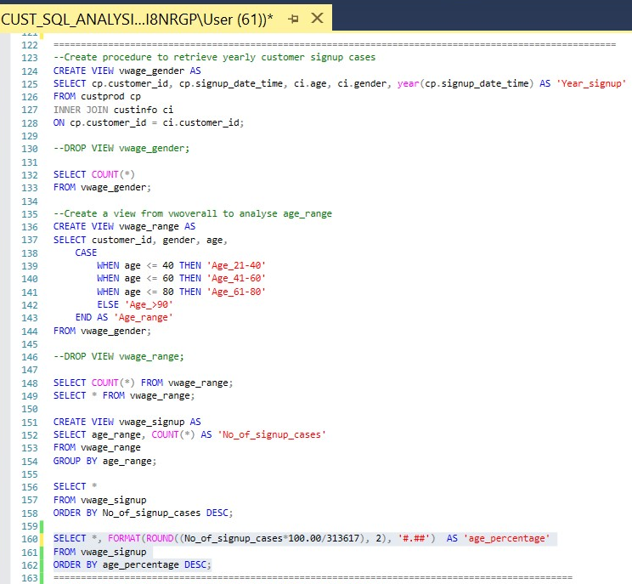
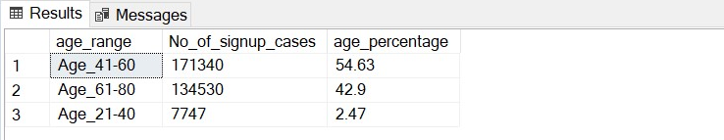
4. Data Analysis using SQL
Customer age demographics.
Divided into three groups based on their age.
55% of the entire population is aged between 41-60.
Notes:
- The dataset shows that 54% of the total subscribers are aged between 41-60 years old.
- Fall in the age group between 41-60 years old.

Slide 17
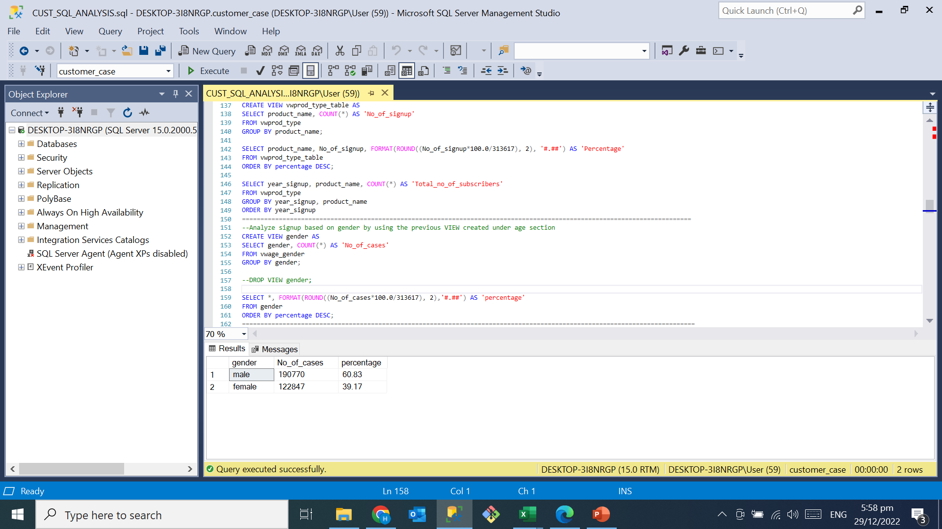
4. Data Analysis using SQL
60% of male subscribers.
40% of female subscribers.
Notes:
- There are more male subscribers than female.

Slide 18
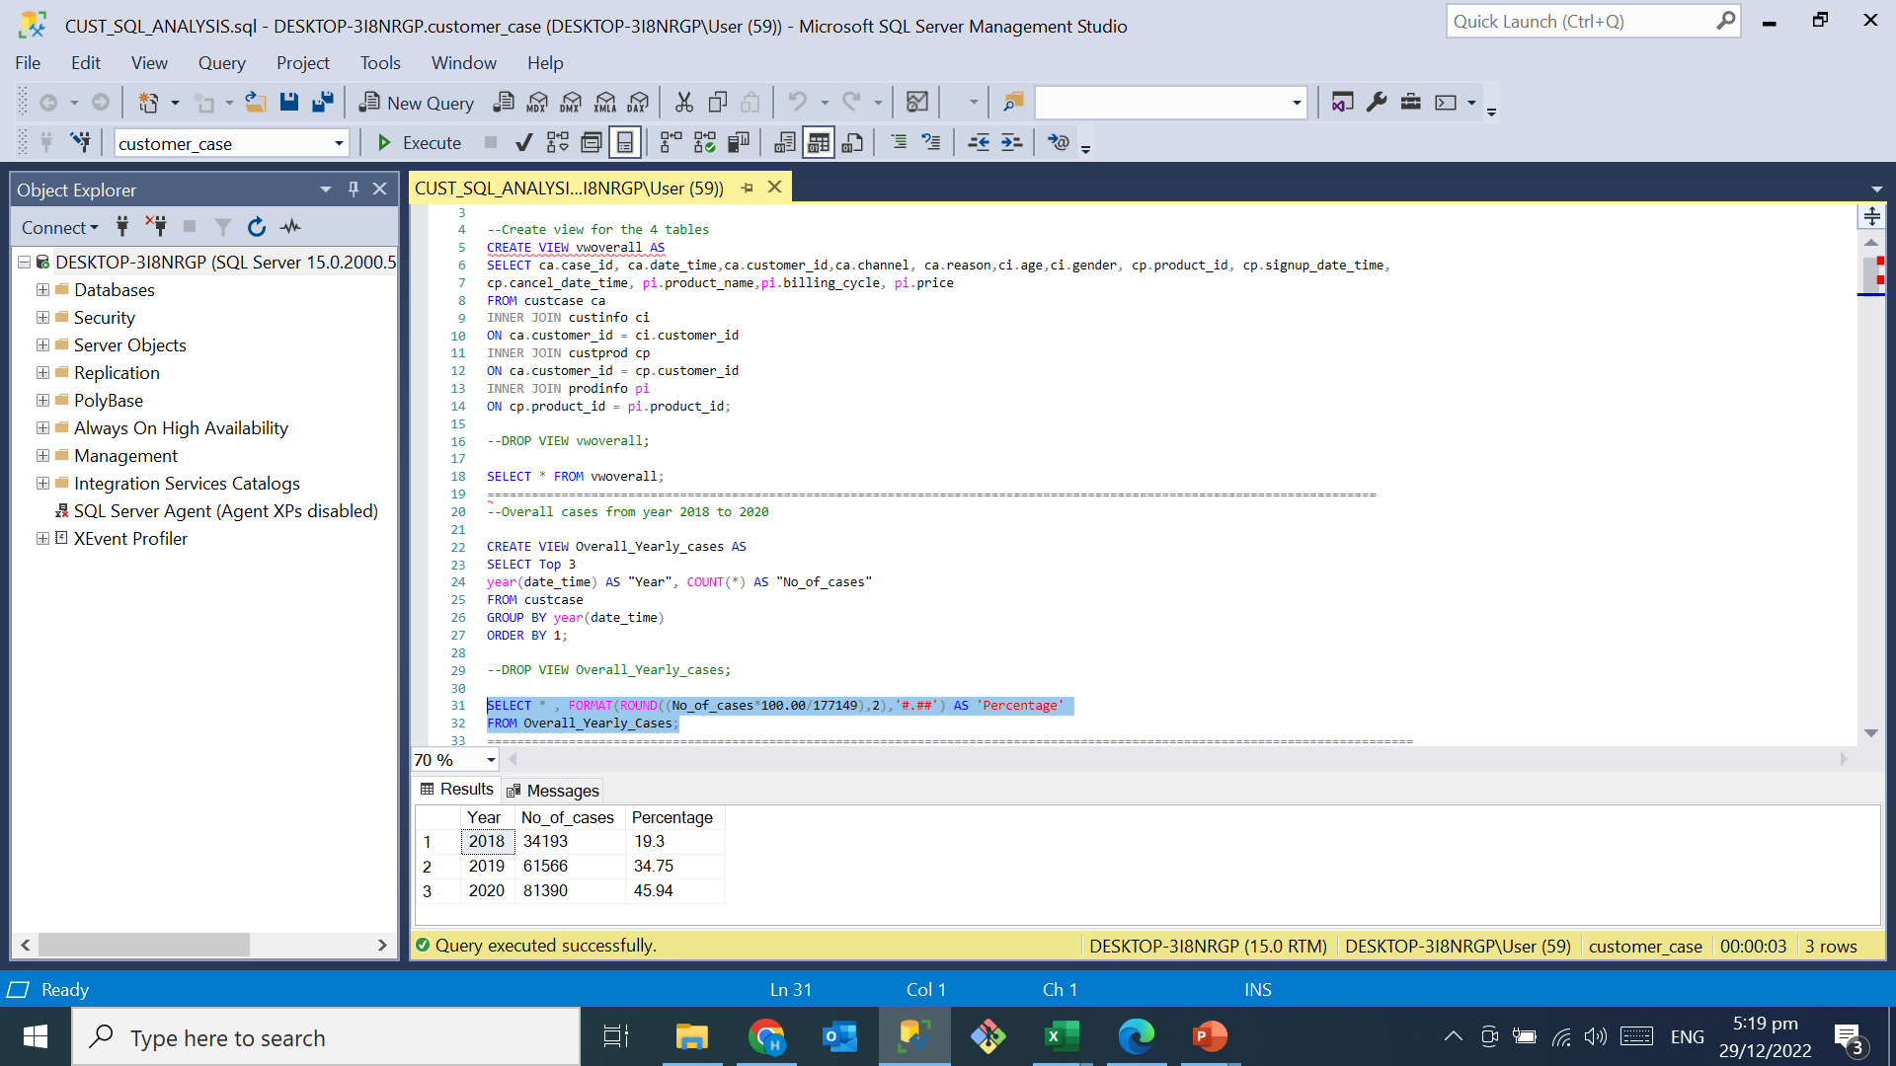
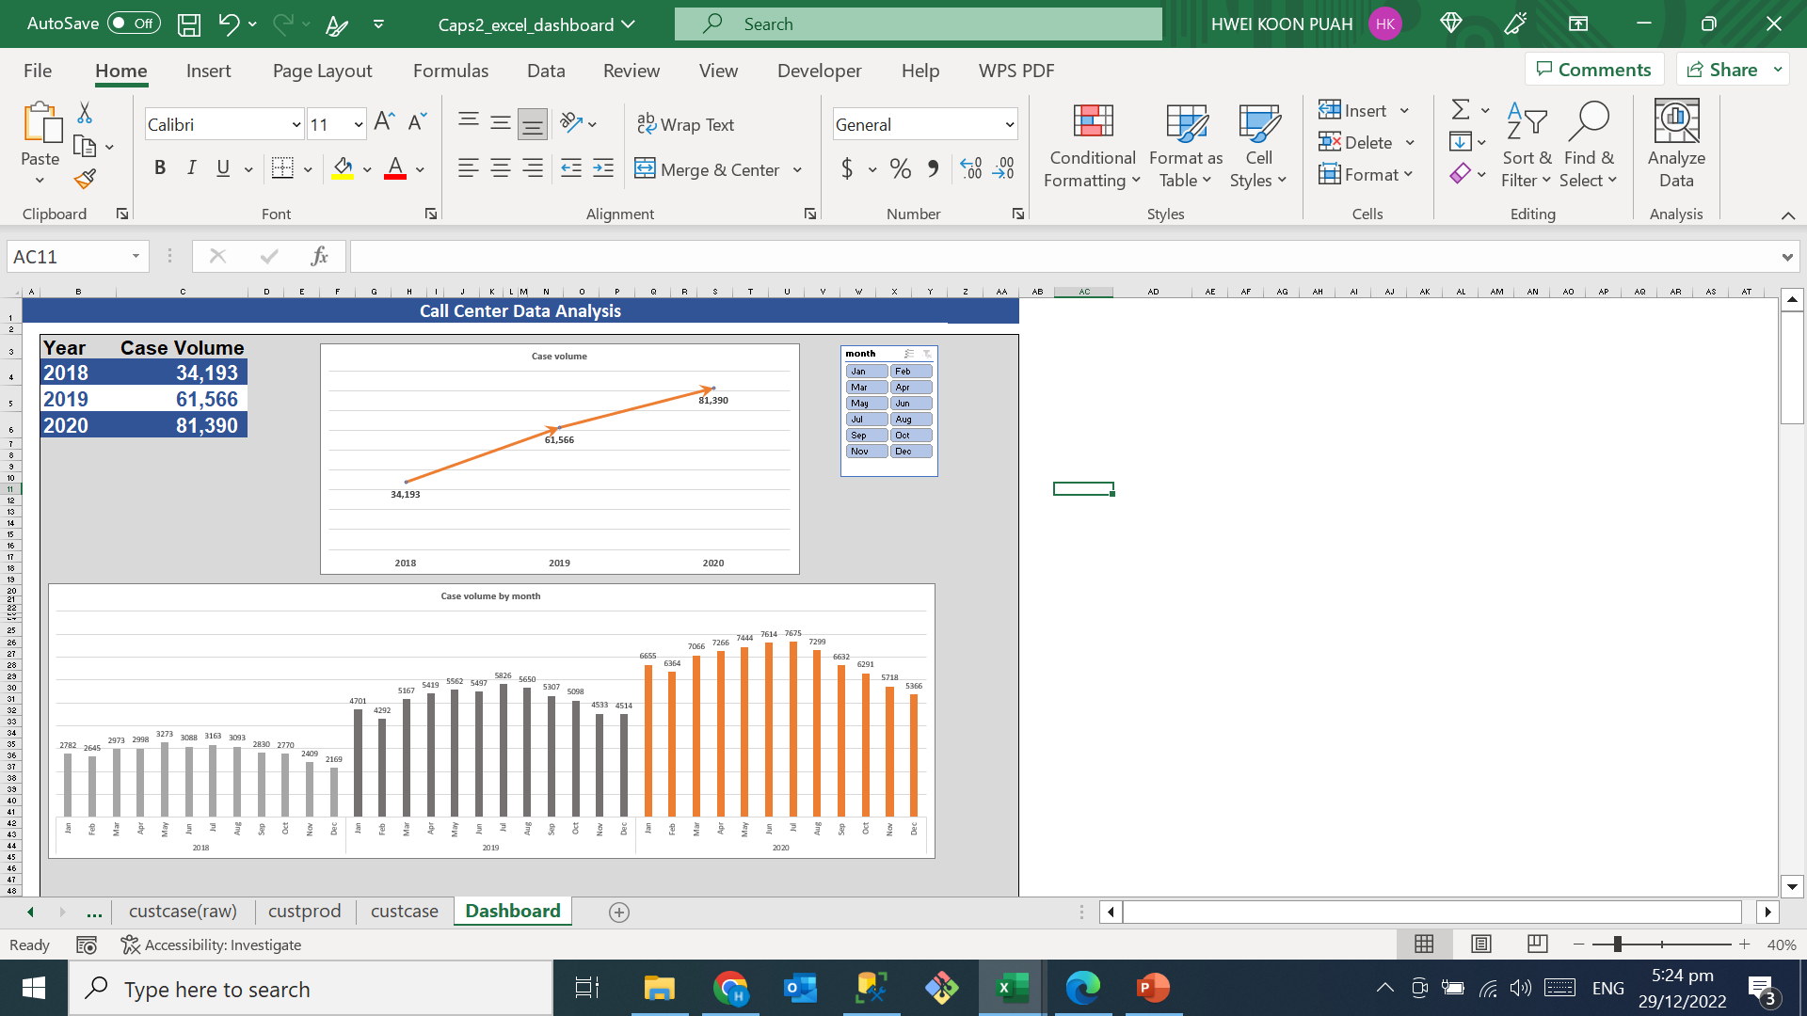
4. Data Analysis using SQL
The line chart below shows case volume for call center from 2018 to 2020.
Upward trend from year 2018 to 2020.
Notes:
- The line chart shows total case volume for year 2018, 2019 and 2020.
It is a clear upward trend from 2018 to 2020.
Case volume increased by 35% in 2019 and 46% increased in 2020.

Slide 19
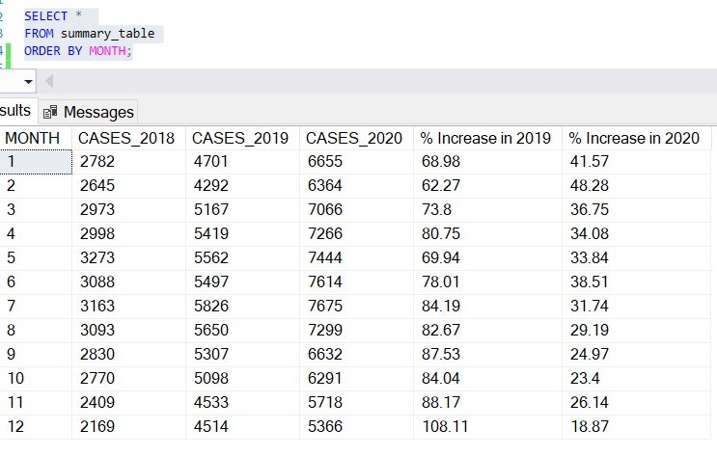
4. Data Analysis using SQL
The bar chart below shows monthly case volume for year 2018, 2019 & 2020.
Notes:
- Lets take a look at the monthly volume

Slide 20
4. Data Analysis using SQL
Recap for case volume
overall view of the case volume for Jan 2018 – Dec 2020 is in an upward trend.

Slide 21
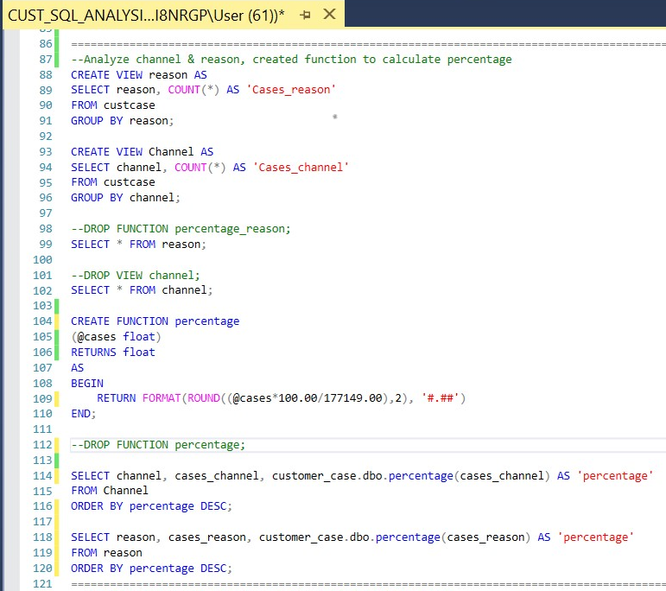
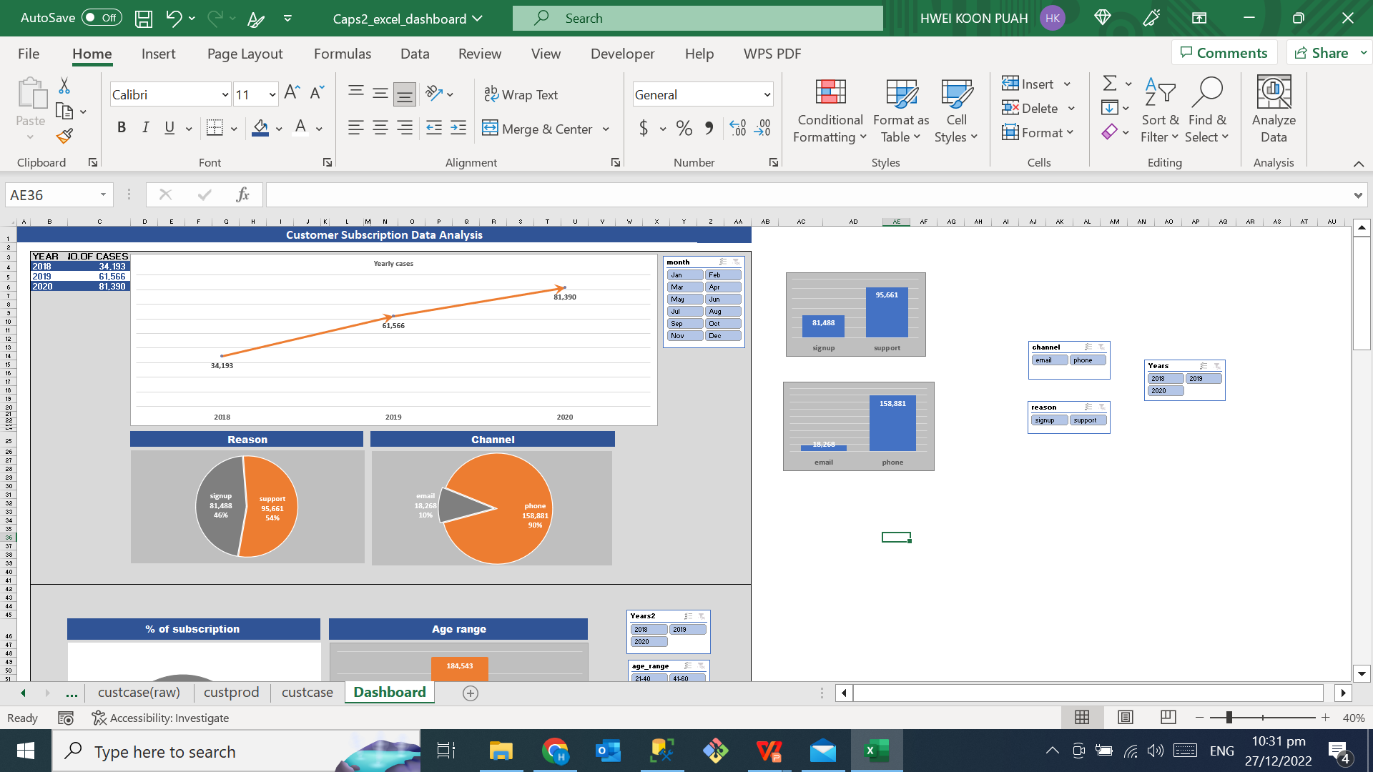
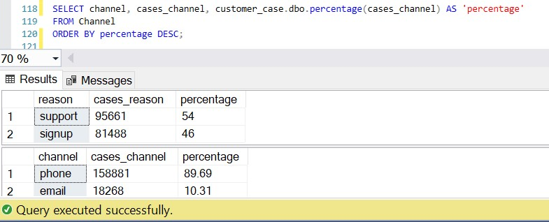
4. Data Analysis using SQL
Case IDs was raised whenever call center is contacted by subscribers to provide service support & opened new account for customers.
Customers could contact call center via email and phone call.

Slide 22
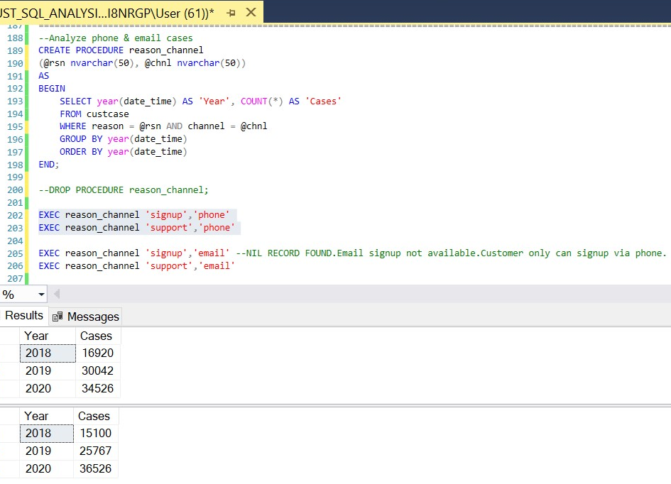
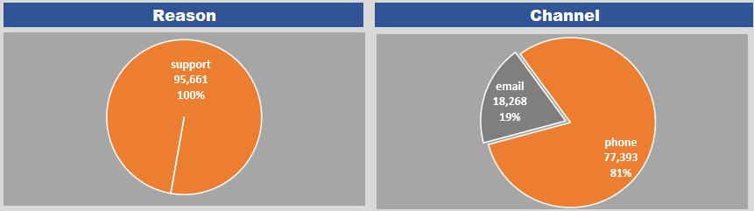
4. Data Analysis using SQL
Call center received request for service support:
Via phone call,
Via email request.
Notes:
An alternative platform can be created for customer to seek support instantly, chatbot is available 24/7, and can respond to customer instantly
I am talking about building an AI virtual assistant, it is a chatbot.
Leverage on the IA technology, build AI chatbot to assist call center to automate repetitive tasks, common requests.
Benefits, make customer service available 24/7, support customers around the clock, can respond to customer instantly, reduce manpower, improve workflows and productivity, enhance customer experience.
Service team can focus on solving complex problems that required human attention.
Improve the user experience to get more sign-ups

Slide 23
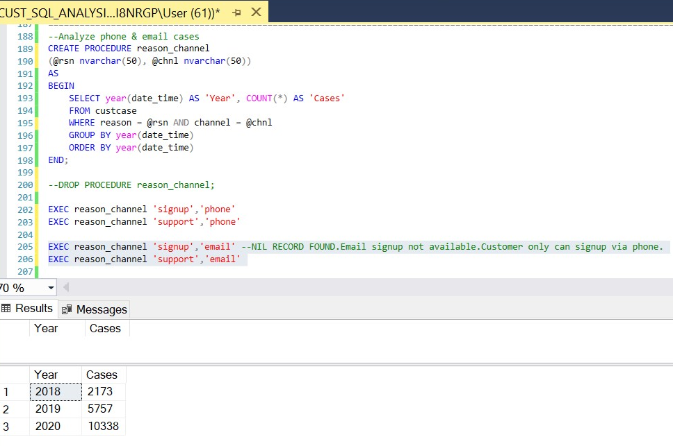
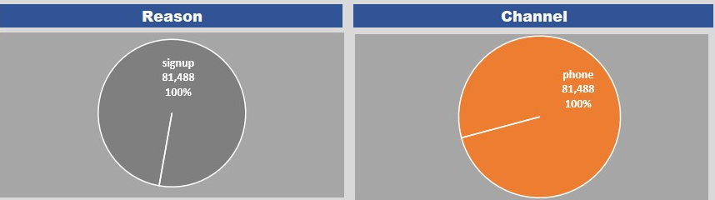
4. Data Analysis using SQL
Creation of new account
Notes:
Automate the signup process. Customers can signup without talking to the call center. This creates a great customer experience,get an instant online subscription account created, as and when they are browsing the company site.
Adding signup form on the header or the footer of the company website can encourage customers to sign up as they browse the site.
Streamlining the signup process also means the company can sign on more customers in less time.
Adding a sign-up button on company’s social media channels. Let customer learn about the news, this is great opportunities to convert customers to subscribers. Social medias like facebook, Instagram
As a subscription-based business, automate subscription process, making signup simple, build a user-friendly self service portalbuild a better experience to new customers

Slide 24
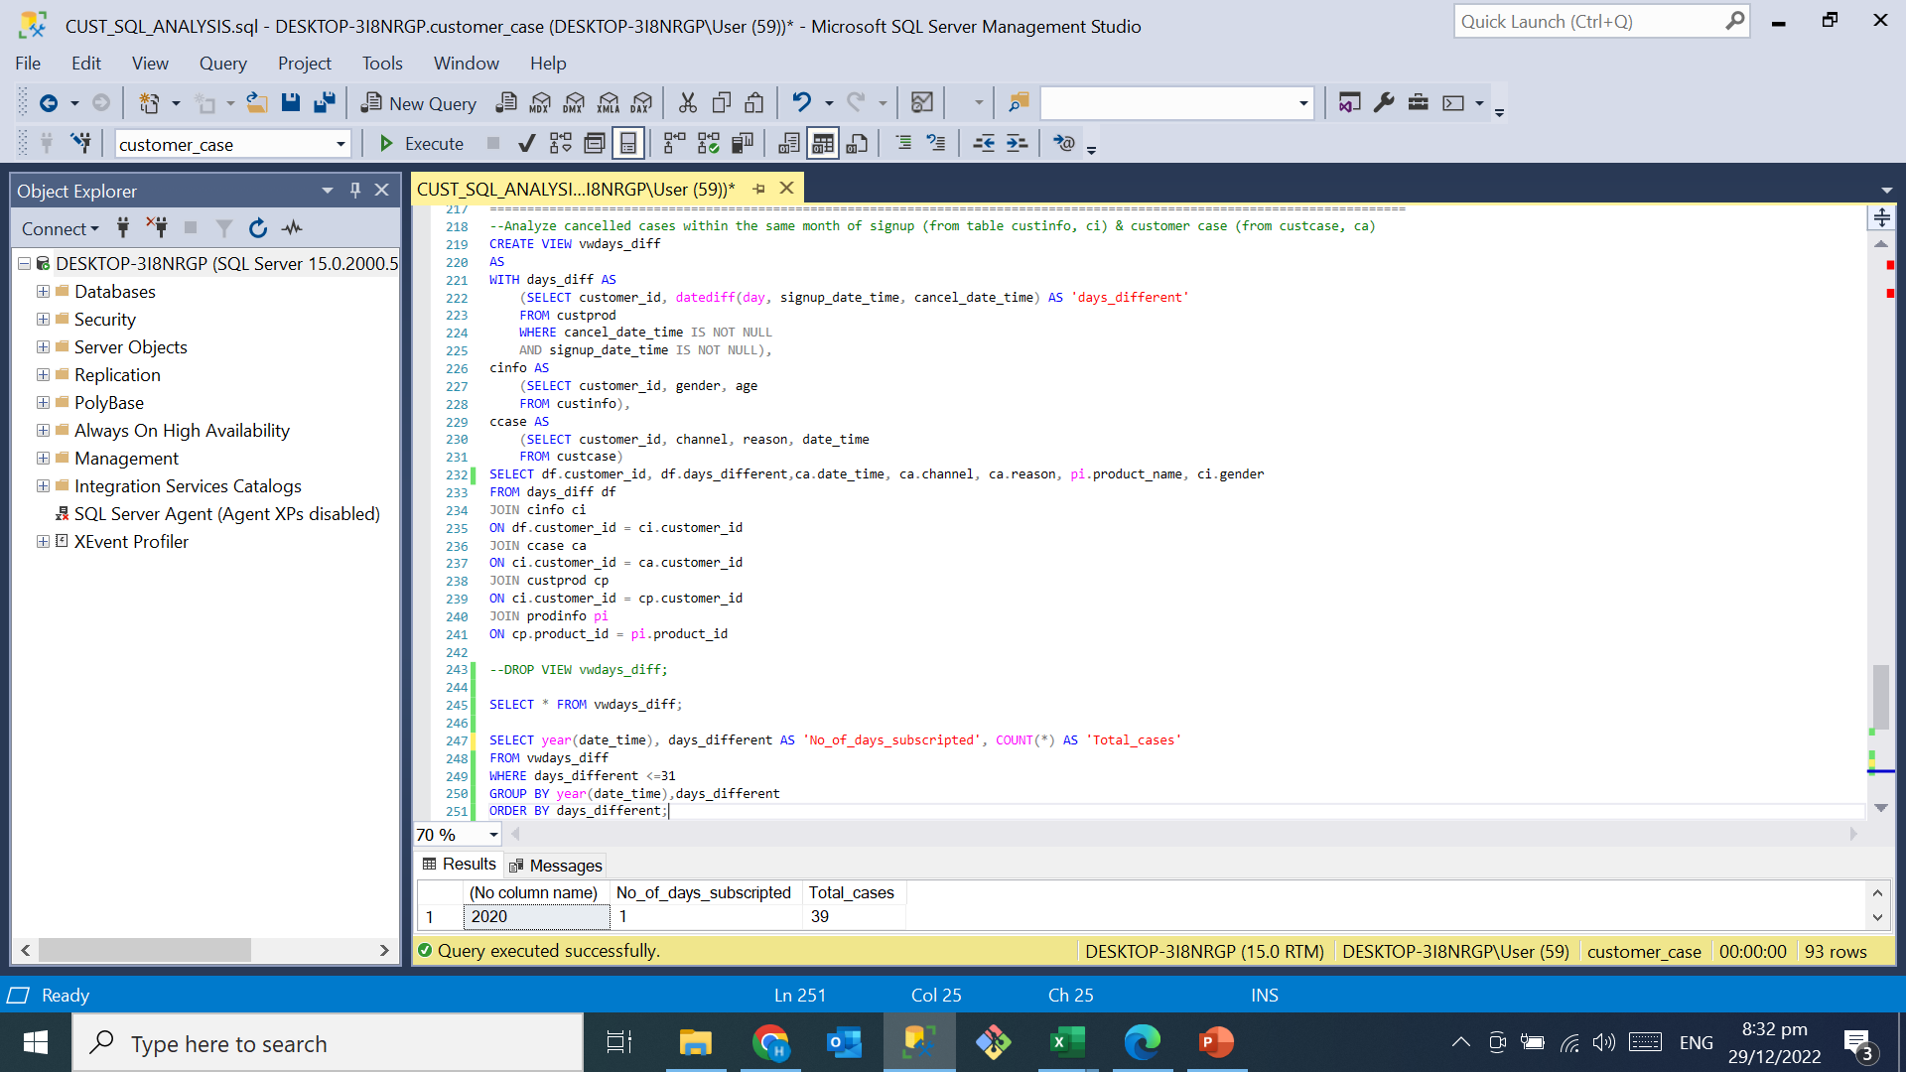
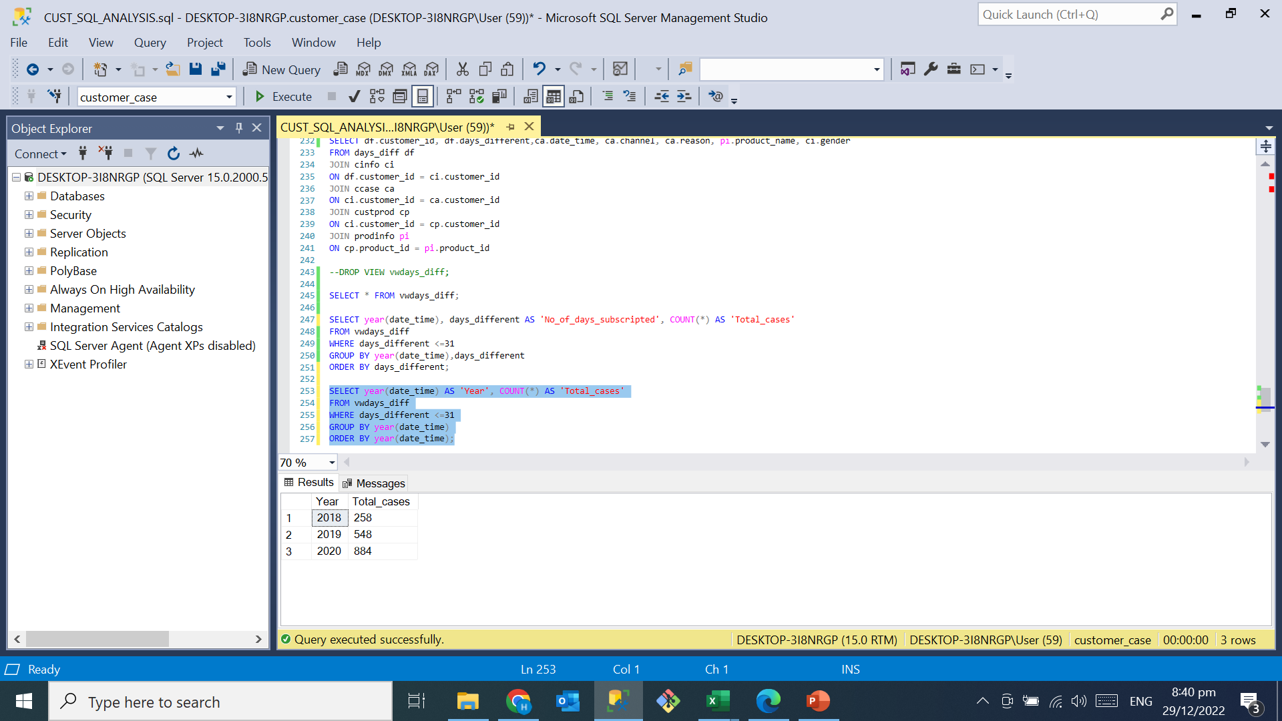
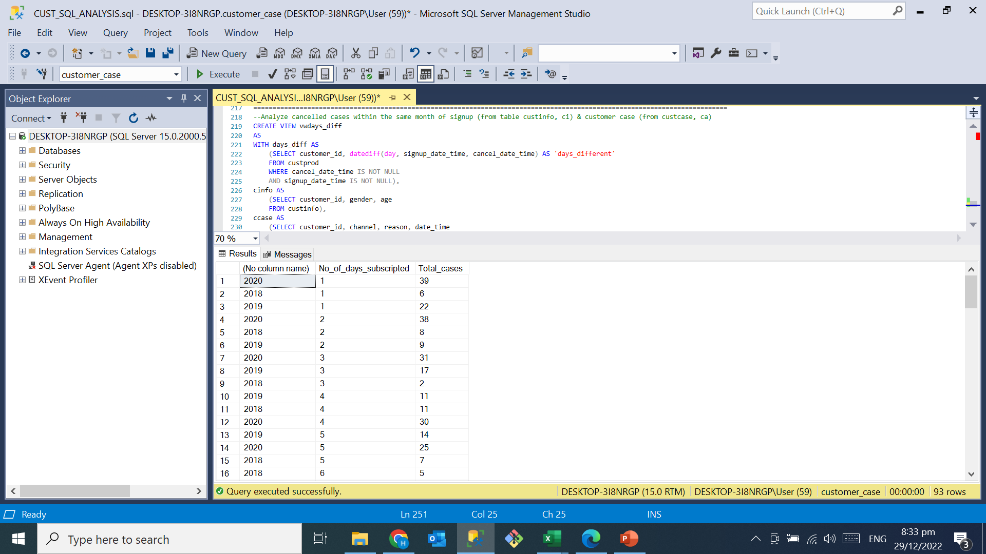
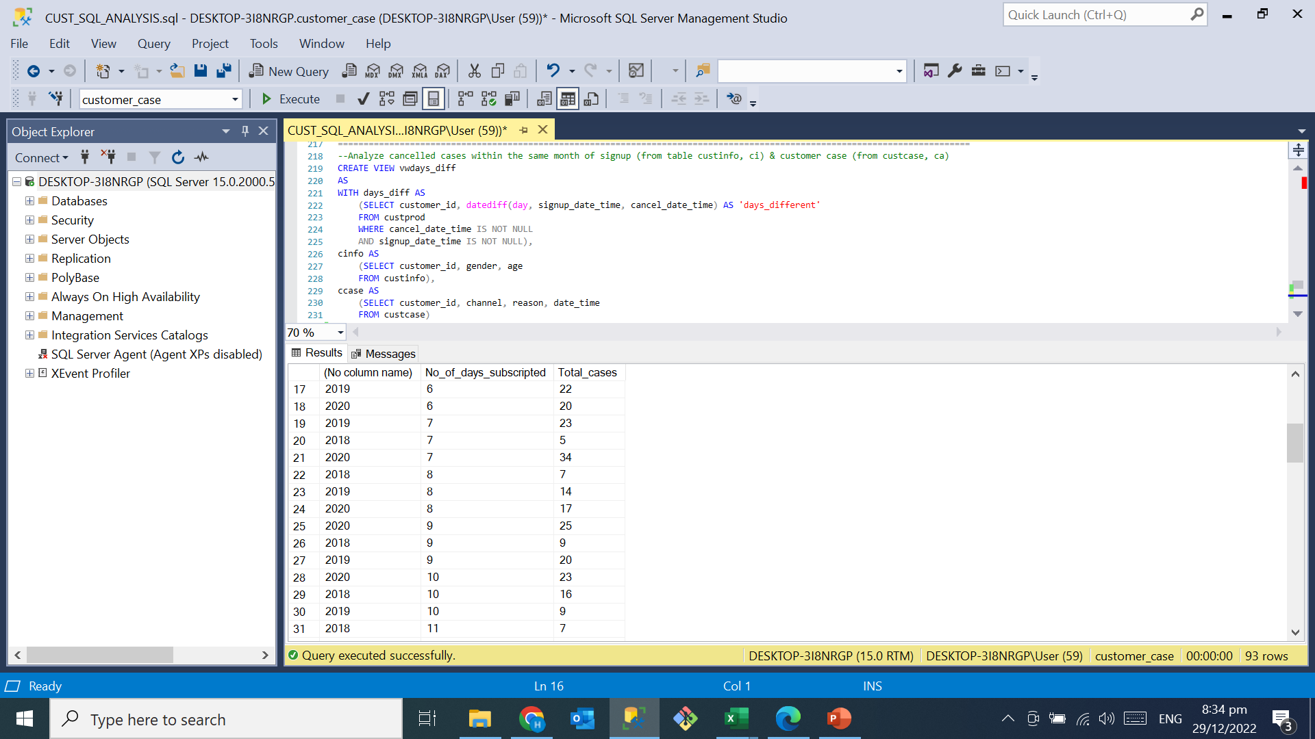
4. Data Analysis using SQL
1690 subscribers signed up and cancelled their accounts in the same month.
258 cases, 548 cases, 884 cases in 2018, 2019 & 2020 respectively.
Insufficient data to dive deeper, so conclusion cannot be drawn.

Slide 25
4. Data Analysis using SQL
s/n | Findings | Recommendations
1 | Call center support teams provided daytime customer support for customers. | Build AI chatbot to provide instant customer support 24/7. Customers could get faster responses and improve customer service response time.
2 | Customer would contact call center via phone for account creation. | Automate sign up process. Customers can sign up any time when they are browsing the company website or social media platforms. This will create better customer experience and enhance sign up rates.
3 | Instances of subscribers signed up and cancelled their subscription plans in the same month. | Insufficient data to investigate the root cause. Relevant data to be provided so that the Analyst could dive deeper into the matters and provide meaningful conclusion.

